Slide 1
Grocery Management System
Presented By
1. GANESH AILI
2. KALYANI SIMMA
3. MUNNAZA FATIMA SAYED
4. RESHAM KANHERE
5. YOGINI KOTTEWAR
Under the guidance of
Mrs. Pooja

Slide 2
INTRODUCTION

Slide 3
INTRODUCTION
We are entering into an era of information explosion, information has become one of the most important resources for any decision making process.
The Information plays most vital role for an organization. Management of an organization requires information in order to take decisions about what to do.
There should therefore be smooth flow of information between different sections of the organization. A computer system is as good as people who operate it.
Which means a system is as good as its worst operator. Thus any computer installation should have a defined set of operating standards which are insurance against failures.
The basic objective of the project is to automate the stock maintaining and billing done for a basic grocery shop.
The project will help the admin, who is maintaining the various records of items sold, items in stock, salespersons, suppliers, etc.
It will also facilitate them with complete computerized maintenance of the records by reducing redundancy of information while improving its accuracy and speed, this project will provide a tremendous opportunity for the grocery store to improve operations productivity and cost-efficiency.

Slide 4
Analysis

Slide 5
SYSTEM SPECIFICATIONS
SOFTWARE SPECIFACTIONS :
• Technology : JAVA
• Business Layer : SpringBoot , Spring Framework, RestAPI , JPA , Hibernate
Database : MySQL
Testing Tool : Postman
• Web Server : Tomcat Server

Slide 6
SYSTEM SPECIFICATIONS
MINIMUM Hardware specifications :
• Pentium-IV(Processor)
• 256 MB Ram
• 512 KB Cache Memory
• Hard disk 10 GB (OPTIONAL)

Slide 7
DESIGN

Slide 8
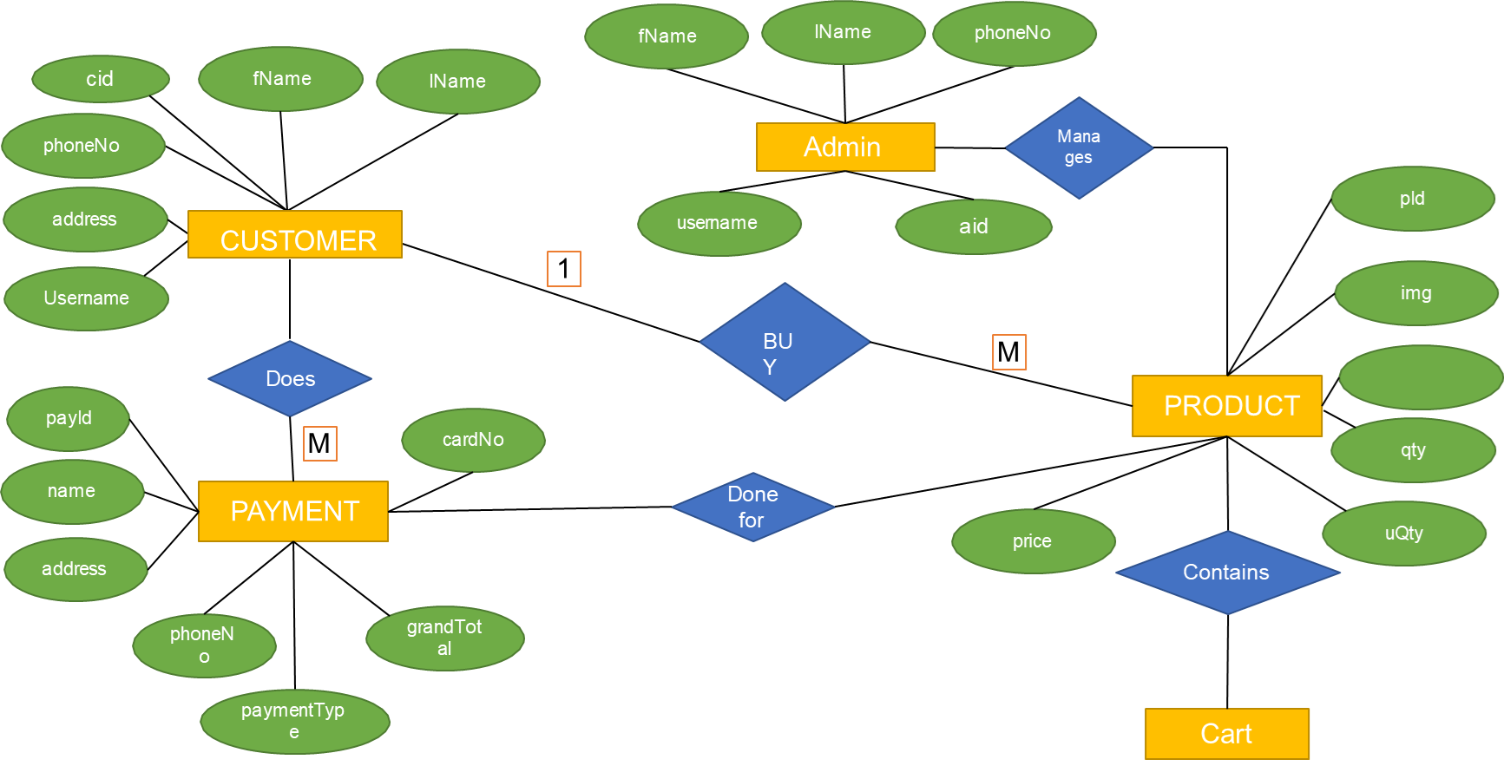
ER DIAGRAM

Slide 9
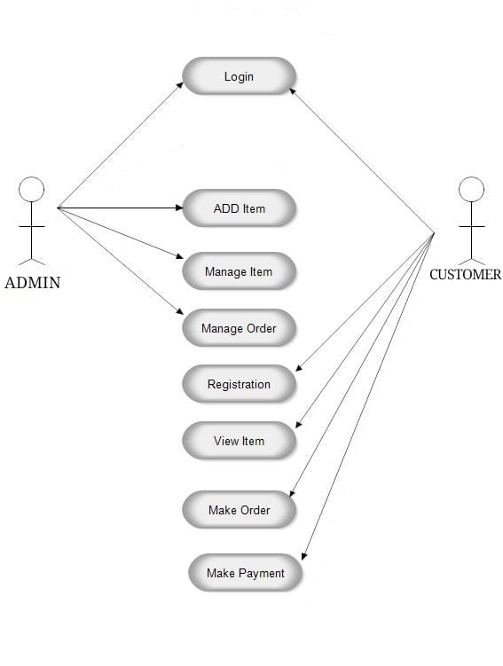
USECASE DIAGRAM

Slide 10
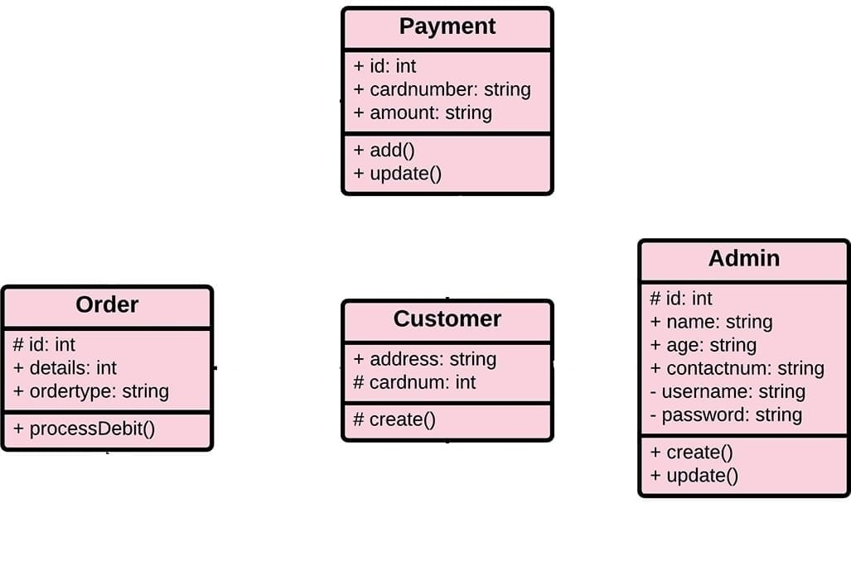
CLASS DIAGRAM

Slide 11
IMPLEMENTATION

Slide 12
IMPLEMENTATION
Implementation is the stage where the theoretical design is turned into a working system.
The most crucial stage in achieving a new successful system and in giving confidence on the new system for the users that it will work efficiently and effectively.
The system can be implemented only after thorough testing is done and if it is found to work according to the specification.
It involves careful planning, investigation of the current system and its constraints on implementation, design of methods to achieve the changeover and an evaluation of change over methods a part from planning.
Two major tasks of preparing the implementation are education and training of the users and testing of the system.

Slide 13
FEASIBILITY STUDY
After responsibility the plan Online Grocery System, study and investigating all the current or compulsory functionalities of the organization, the next job is to do the viability study for the project.
All plans feasible – given limitless resources and immeasurable time. All the conceivable ways to deliver a solution to the given problem are find by feasibility study.
This planned answer would please all the worker need and must be flexible plenty so that future studies can be simply done founded on the future imminent supplies.

Slide 14
ECONOMIC FEASIBILITY
This is very important aspects to be considered while developing a project.
We decided the technology for our project founded on smallest conceivable charge influence.
Entirely tools and system fee obligates to be done by developer.
Completely we have projected that the benefits the creator is going to receive from the planned system will surely dazed the initial prices and the later on organizational cost for system.

Slide 15
TECHNICAL FEASIBILITY
The technical feasibility education contains study of function, presentation and restraints that may move the ability to achieve a suitable system.
For this possibility study, we deliberate whole functionality to be in the organization, as labelled in the System Obligation Specification (SOS), and checked if the whole thing was possible using the different types of frontend and backend operations

Slide 16
MODULES

Slide 17
MODULES
Admin :
Admin has the official powers to control the flow of the data from one part of the system to the other.
He can manipulate the access of the users to the data.
Hence all the data will be reflected in clean and well data in the interfaces.
• Customer :
Check the all products and give order of products. Check order status and see recently add cart products.
• Order:
The order from the dealer is taken through phone and the products; quality is entered by an employee. After that it resolve be saved in the database and a crystal account will have produced for billing purpose.

Slide 18
Cart :
After trade, the products will be directed to the cart. In the cart unit we can get the total quantity of products available.
• Payment :
Configurable to permit and charge, or authorize only and on conception of invoices.
Cash on delivery available.
• Product :
Detail information about product which is provided by admin.

Slide 19
OVERVIEW OF TECHNOLOGIES USED

Slide 20
About JAVA
JAVA was developed by James Gosling at Sun Microsystems Inc in the year 1995, later acquired by Oracle Corporation.
It is a simple programming language. Java makes writing, compiling, and debugging programming easy. It helps to create reusable code and modular programs.
Java is a class-based, object-oriented programming language and is designed to have as few implementation dependencies as possible.
A general-purpose programming language made for developers to write once run anywhere that is compiled Java code can run on all platforms that support Java.
Java applications are compiled to byte code that can run on any Java Virtual Machine. The syntax of Java is similar to c/c++.

Slide 21
About SpringBoot
Spring Boot is an open-source micro framework maintained by a company called Pivotal.
It provides Java developers with a platform to get started with an auto configurable production-grade Spring application.
With it, developers can get started quickly without losing time on preparing and configuring their Spring application.
Spring Boot is built on top of the Spring framework, and it comes with many dependencies that can be plugged into the Spring application.
Some examples are Spring Kafka, Spring LDAP, Spring Web Services, and Spring Security.
However, developers have to configure each building brick themselves using a lot of XML configuration files or annotations
The main goal of the Spring Boot framework is to reduce overall development time and increase efficiency by having a default setup for unit and integration tests.
If you want to get started quickly with your Java application, you can easily accept all defaults and avoid the XML configuration completely.

Slide 22
What’s the Difference Between Spring and Spring Boot?
Well, the Spring framework focuses on providing flexibility through its dependency injection feature.
It helps to inject the required dependencies quickly but also to develop your application in a loosely coupled fashion.
Some other benefits include: A lightweight framework. Helps with loose coupling dependencies and testability. The modular architecture allows you to pick the parts you need and isolate them.
Has support for both XML and annotation configuration.
Spring Boot, on the other hand, is focused on shortening the code length and providing you with an easy way to run your Spring application.

Slide 23
Features of SPRINGBOOT
Auto configuration: Developers can automatically configure their Spring application.
However, Spring Boot is also capable of changing the configuration based on the dependencies you list.
For example, when you list “MySQL” as a dependency, it will configure your Spring application with the “MySQL connector” included.
And if you want to add a custom configuration, you can create a class that overrides the default configuration for your “MySQL connector”.
Standalone: There’s no need to deploy your application to a web server. You simply enter the run command to start the application.

Slide 24
REST API
Representational State Transfer (REST) is an architectural style that defines a set of constraints to be used for creating web services. REST API is a way of accessing web services in a simple and flexible way without having any processing.
It’s used to fetch or give some information from a web service. All communication done via REST API uses only HTTP request.
An API for a website is code that allows two software programs to communicate with each other. The API spells out the proper way for a developer to write a program requesting services from an operating system or other application.
Working : A request is sent from client to server in the form of a web URL as HTTP GET or POST or PUT or DELETE request. After that, a response comes back from the server in the form of a resource which can be anything like HTML, XML, Image, or JSON. But now JSON is the most popular format being used in Web Services.

Slide 25
In HTTP there are 4 methods that are commonly used in a REST-based Architecture i.e., POST, GET, PUT, and DELETE.
GET: The HTTP GET method is used to read (or retrieve) a representation of a resource. In the safe path, GET returns a representation in XML or JSON and an HTTP response code of 200 (OK). In an error case, it most often returns a 404 (NOT FOUND) or 400 (BAD REQUEST).
POST: The POST verb is most often utilized to create new resources. In particular, it’s used to create subordinate resources. That is, subordinate to some other (e.g. parent) resource. On successful creation, return HTTP status 201, returning a Location header with a link to the newly-created resource with the 201 HTTP status.
PUT: It is used for updating the capabilities. However, PUT can also be used to create a resource in the case where the resource ID is chosen by the client instead of by the server. In other words, if the PUT is to a URI that contains the value of a non-existent resource ID. On successful update, return 200 (or 204 if not returning any content in the body) from a PUT.
DELETE: It is used to delete a resource identified by a URI. On successful deletion, return HTTP status 200 (OK) along with a response body.

Slide 26
JPA ( JAVA PERSISTANCE API )
JPA stands for Java Persistence API (Application Programming Interface). It was initially released on 11 May 2006.
It is a Java specification that gives some functionality and standard to ORM tools. It is used to examine, control, and persist data between Java objects and relational databases.
The JPA specification defines the object-relational mapping internally, rather than relying on vendor- specific mapping implementations.
JPA is based on the Java programming model that applies to Java Enterprise Edition (Java EE) environments, but JPA can function within a Java SE environment for testing application functions.
JPA represents a simplification of the persistence programming model.
The JPA specification explicitly defines the object-relational mapping, rather than relying on vendor-specific mapping implementations.
JPA standardizes the important task of object-relational mapping by using annotations or XML to map objects into one or more tables of a database.

Slide 27
HIBERNATE
Hibernate is a framework in Java which comes with an abstraction layer and handles the implementations internally.
The implementations include tasks like writing a query for CRUD operations or establishing a connection with the databases, etc
Hibernate is a ORM tool means it support Object relational mapping. Whereas JDBC is not object oriented moreover we are dealing with values means primitive data. In hibernate each record is represented as a Object but in JDBC each record is nothing but a data which is nothing but primitive values.
Benefits of Hibernate :
Any changes made are encapsulated in the data source itself, so that when those sources or their application programming interfaces (APIs) change, the applications that use ORM don't have to make changes or even be aware of that information.
Similarly, programmers can have a consistent view of objects over time, although the sources that deliver them, the sinks that receive them and the applications that access them may change.
Hibernate is freely available to download and is licensed under the open source GNU Lesser General Public License (LGPL).

Slide 28
DIFFERENCE BETWEEN JPA AND HIBERNATE
JPA | HIBERNATE
JPA is described in javax.persistence package. | Hibernate is described in org.hibernate package.
It describes the handling of relational data in Java applications. | Hibernate is an Object-Relational Mapping (ORM) tool that is used to save the Java objects in the relational database system.
It is not an implementation. It is only a Java specification. | Hibernate is an implementation of JPA. Hence, the common standard which is given by JPA is followed by Hibernate.
It is a standard API that permits to perform database operations. | It is used in mapping Java data types with SQL data types and database tables.
As an object-oriented query language, it uses Java Persistence Query Language (JPQL) to execute database operations. | As an object-oriented query language, it uses Hibernate Query Language (HQL) to execute database operations.

Slide 29
About MySQL
There are a large number of database management systems currently available, some commercial and some free. Some of them: Oracle, Microsoft Access, Mysql.
These database systems are powerful, feature-rich software, capable of organizing and searching millions of records at very high speeds.
Understanding Databases, Records, and Primary Keys :
Every Database is composed of one or more tables.These Tables, which structure data into rows and columns, Impose organization on the data.
The records in a table(below) are not arranged in any particular order.To make it easy to identify a specific record, therefore, it becomes necessary.

Slide 30
About POSTMAN
Postman is an Application Programming Interface (API) testing tool. API acts like an interface between a couple of applications and establishes a connection between them.
Thus, an API is a collection of agreements, functions, and tools that an application can provide to its users for successful communication with another application.
We require an API whenever we access an application like checking news over the phone, Facebook, and so on.
Postman was designed in the year 2012 by software developer and entrepreneur Abhinav Asthana to make API development and testing straightforward.
It is a tool for testing the software of an API. It can be used to design, document, verify, create, and change APIs.
Postman has the feature of sending and observing the Hypertext Transfer Protocol (HTTP) requests and responses.
It has a graphical user interface (GUI) and can be used in platforms like Linux, Windows and Mac.
It can build multiple HTTP requests − POST, PUT, GET, PATCH and translate them to code.

Slide 31
OUTPUT SCREENS

Slide 32
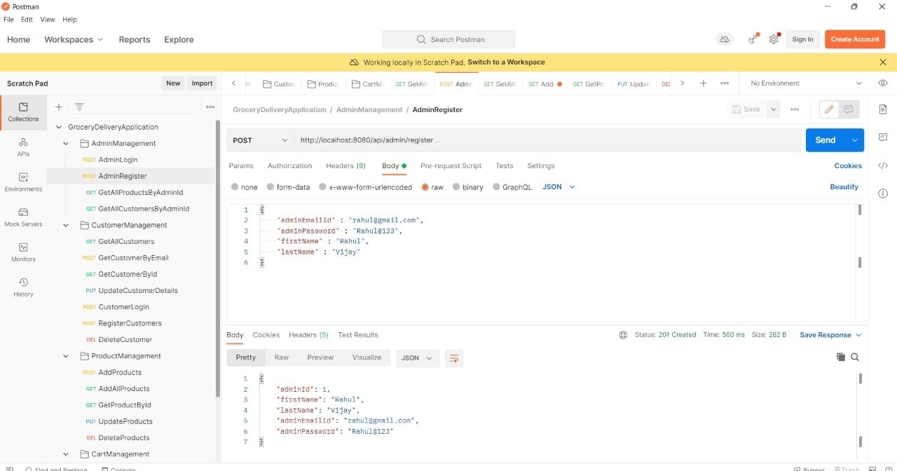

Slide 33
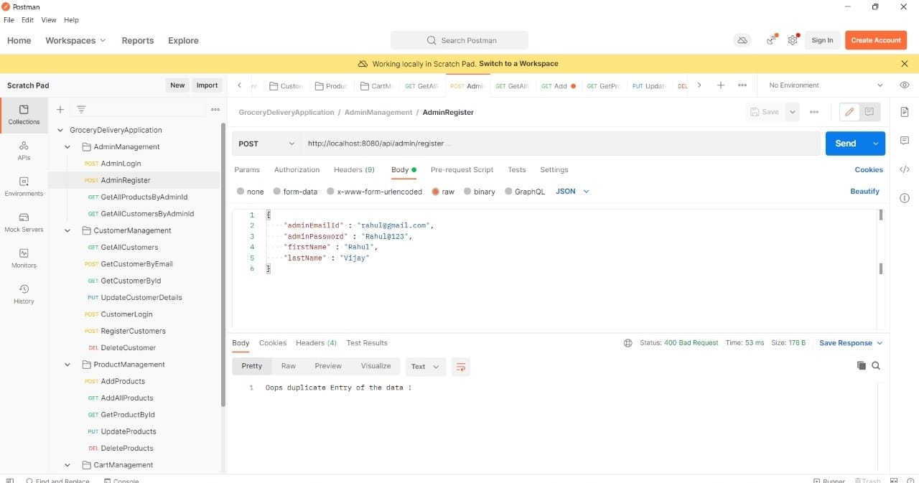

Slide 34
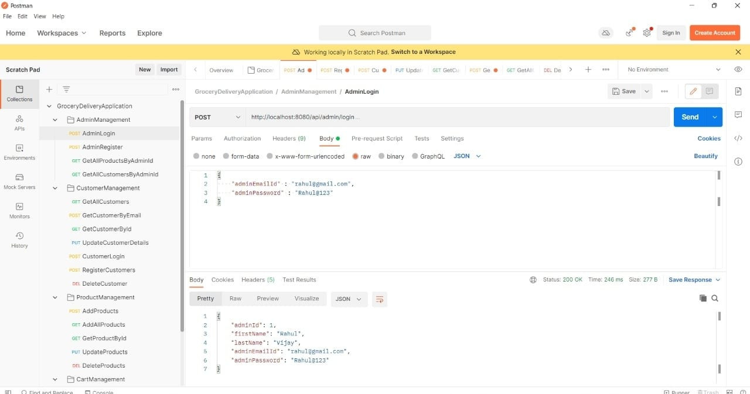

Slide 35
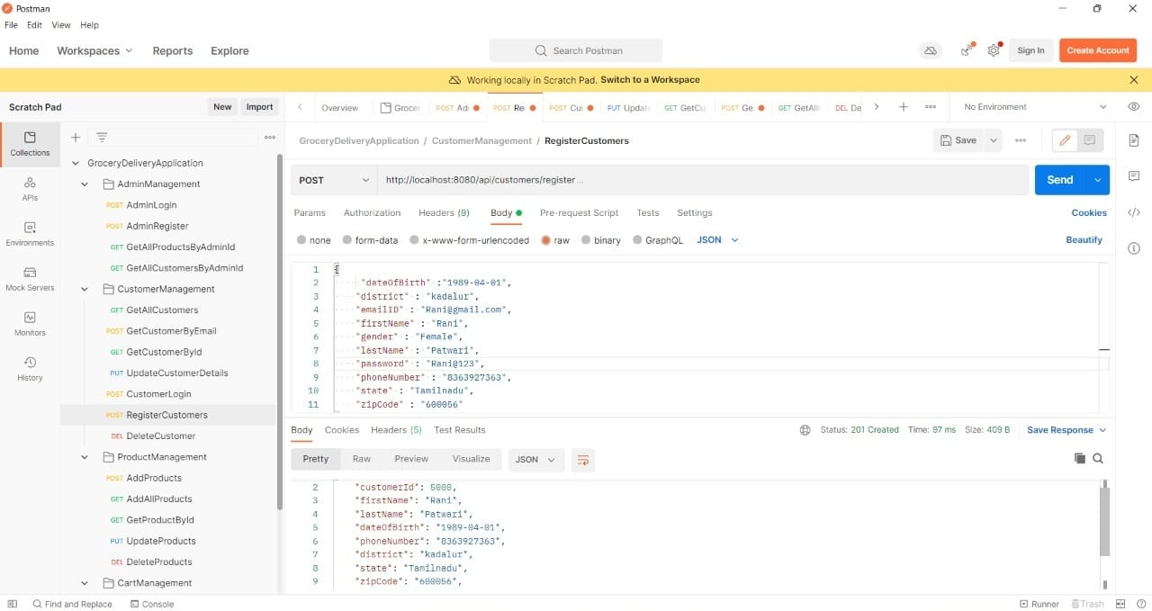

Slide 36
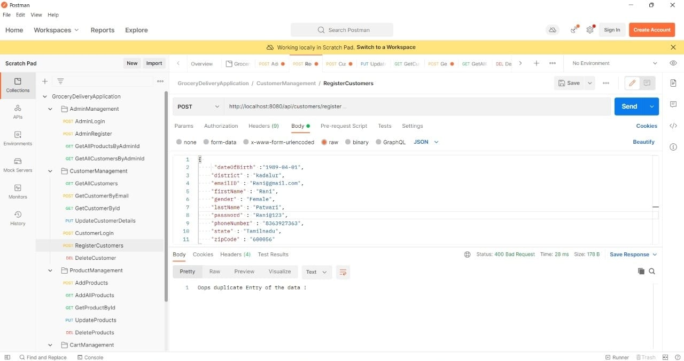

Slide 37
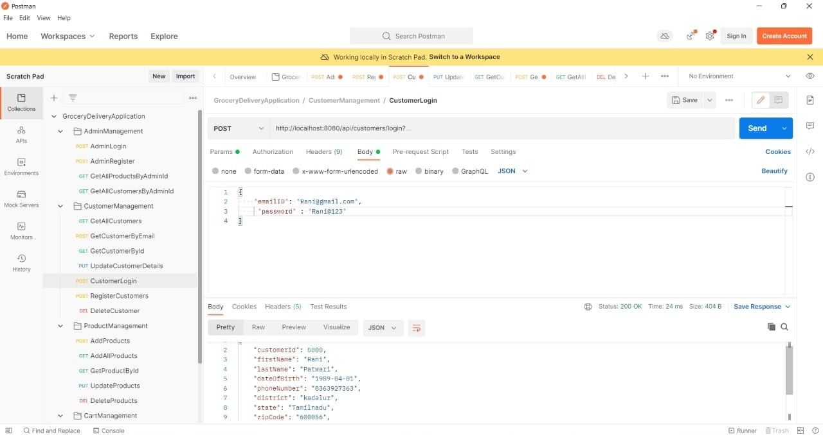

Slide 38
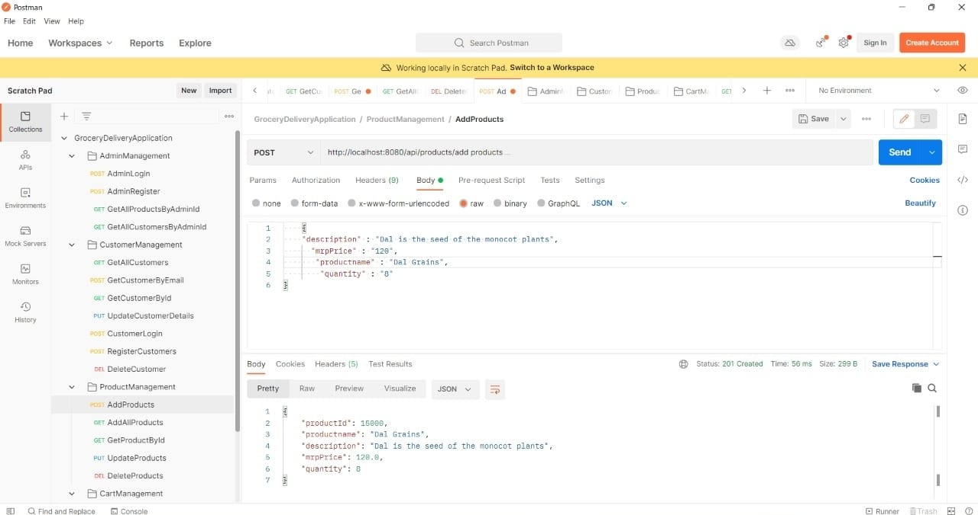

Slide 39
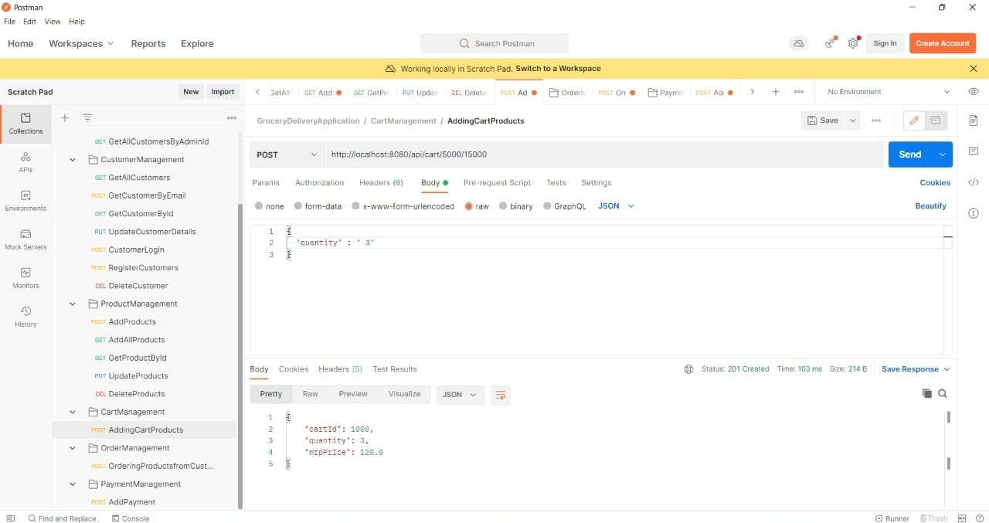

Slide 40
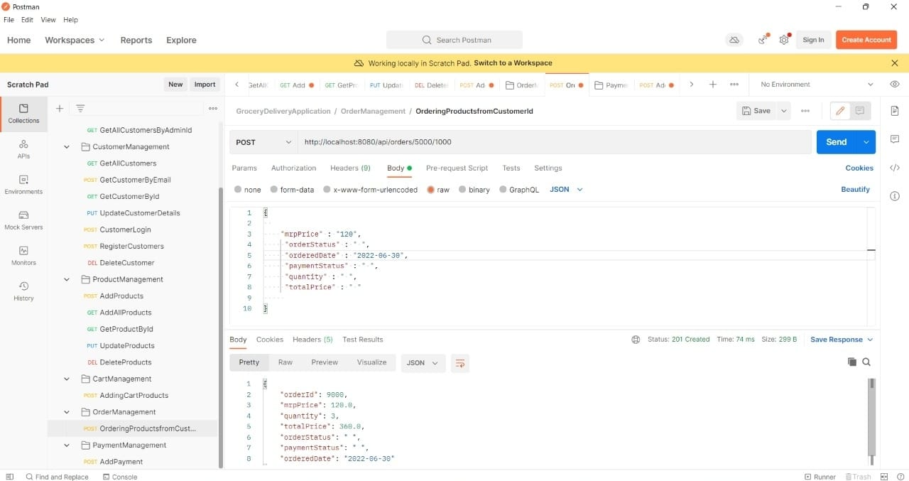

Slide 41
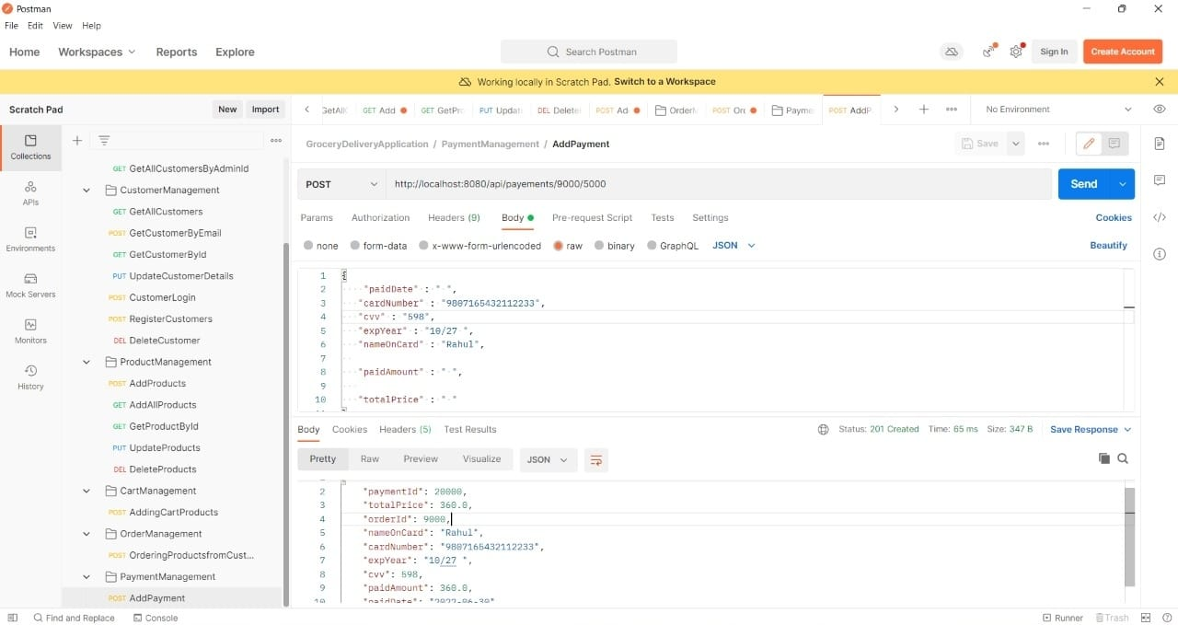

Slide 42
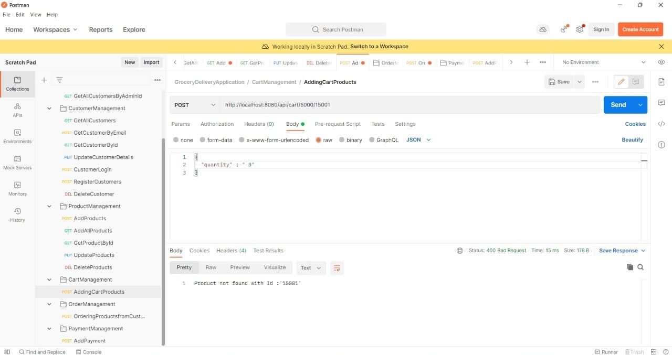

Slide 43
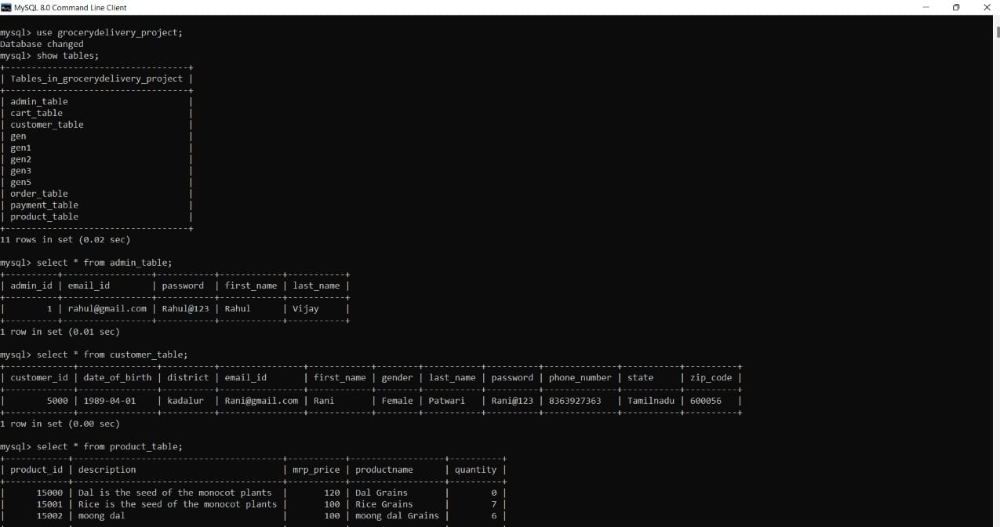

Slide 44
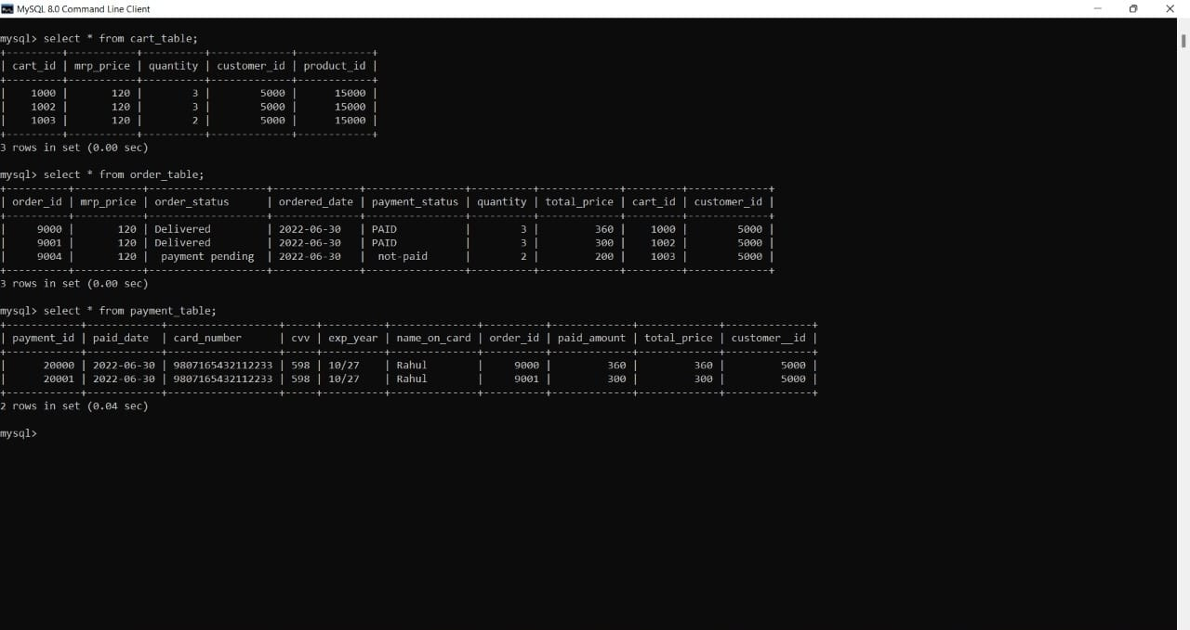

Slide 45
CONCLUSION

Slide 46
Finally, in the grocery management system, we have a system where users order the item according to the wish given by the filters he chooses and specify the no, of it and makes the payment.
He gets the order as staff picks out the items from the racks and give to the user.
Admin assigns the staff to the racks.
In the analyzes, the profit and gain and booking for the customers.

Slide 47
FUTURE SCOPE AND ENHANCEMENT

Slide 48
FUTURE SCOPE
The Management Information System makes the whole process of managing the details of the Grocery Store e.g. details of Items sold, profit, details of the transactions made i.e. sales of items to the customer and purchase of items from the supplier.
We hope that the present software will be valuable help in easing the work load of the office staff of the Grocery Store.It shall make the management of the various transactions, stocks, records and analysis of these very simple and fast.
The software has been tested for various test cases and has shown satisfactory results. Further it was noticed that it performed fairly well even, the size of the database is large. As the size of database increases the response time of the application may increase.

Slide 49
ENHANCEMENT
We are confident that in the next release of the Management Information System we shall incorporate the enhanced features as mentioned below.
This project can be further developed.The further enhancement can be in Leave and salary management of the salesman.
We can include inventory accounting as well as finance accounting in this software.
In future we can develop front-end for this.

Slide 50
REFERENCES

Slide 51
www.google.com.
Hoovers (2008a), Industry Proﬁle: Grocery Stores and Supermarkets, available at: http://premium.hoovers.com.proxy1.cl.msu.edu:2047/subscribe/ind/fr/proﬁle/basic. xhtml?ID = 84 ( accessed May 20)..

Slide 52

THANK YOU

